Slide 1
Microbiome Challenge
Niklas Probul

Slide 2
Table of Contents
Microbiomes?
The Challenge
The Data
Extension

Slide 3
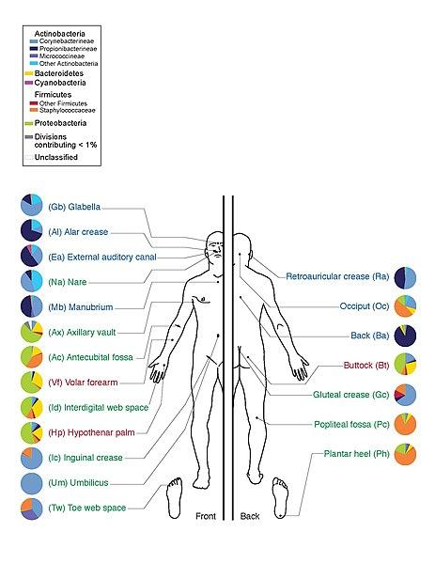
Microbiomes?

Slide 4
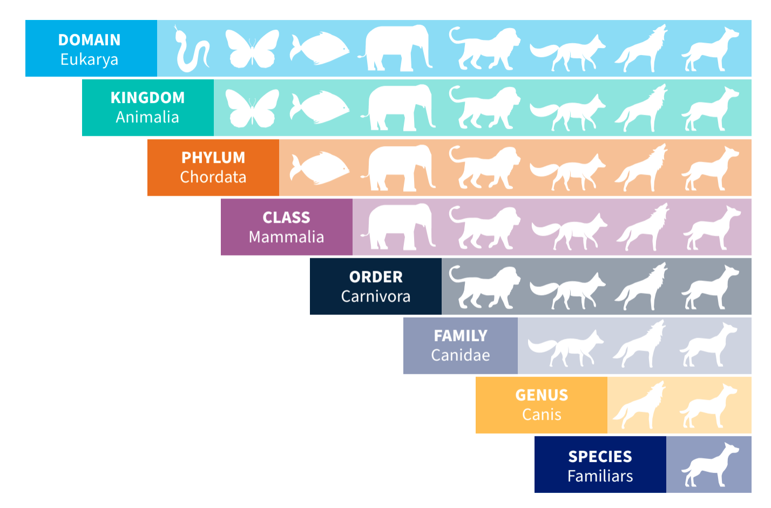
Microbiomes?

Slide 5
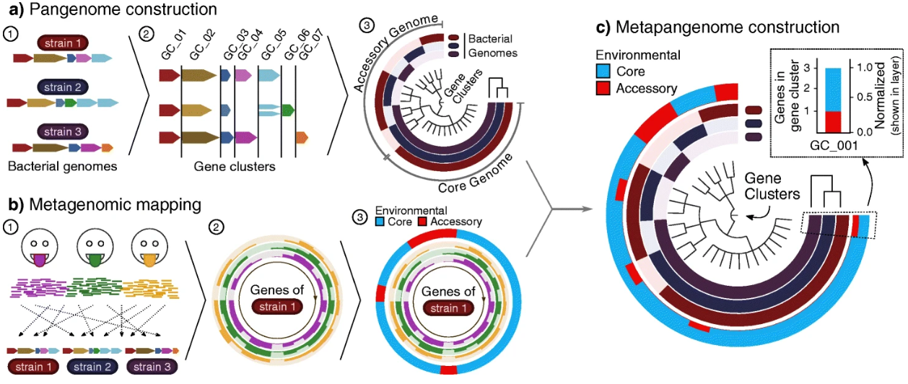
Microbiomes?

Slide 6
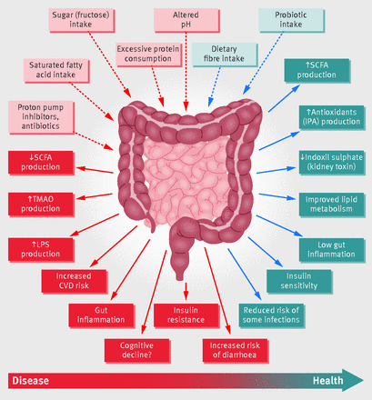
The Challenge -
CRC Prediction
Goal: Classify patient/healthy (‘health_status’)
Sensitivity > Specificity
→ minimize false negatives!

Slide 7
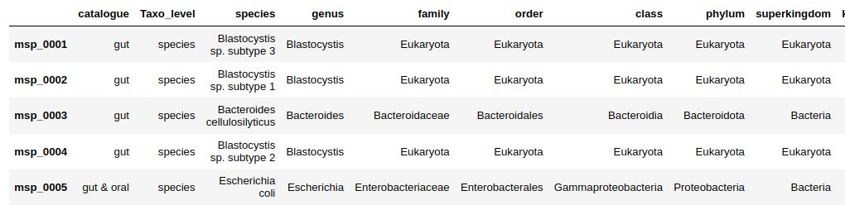
The Data - taxonomic information

Slide 8
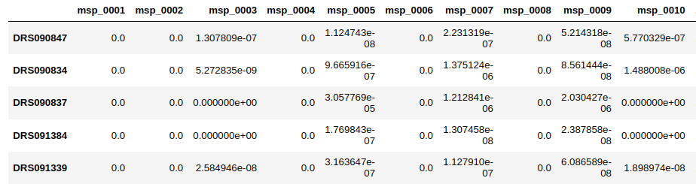
The Data - metagenome counts

Slide 9
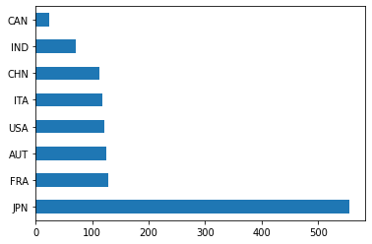
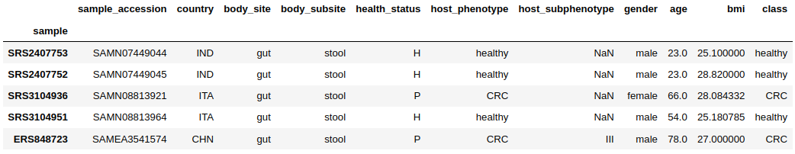
The Data - medical information

Slide 10
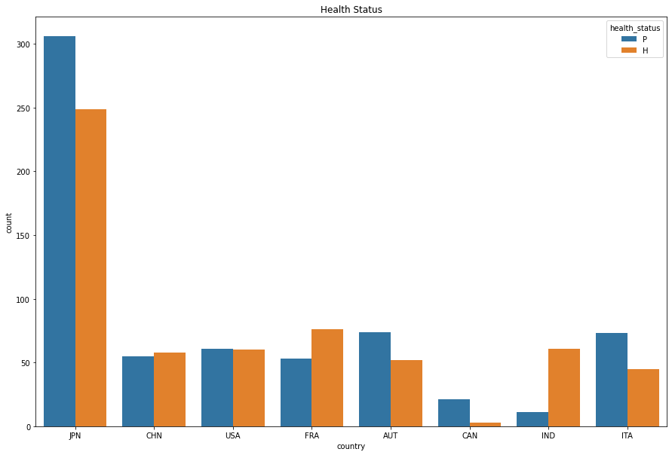
The Data

Slide 11
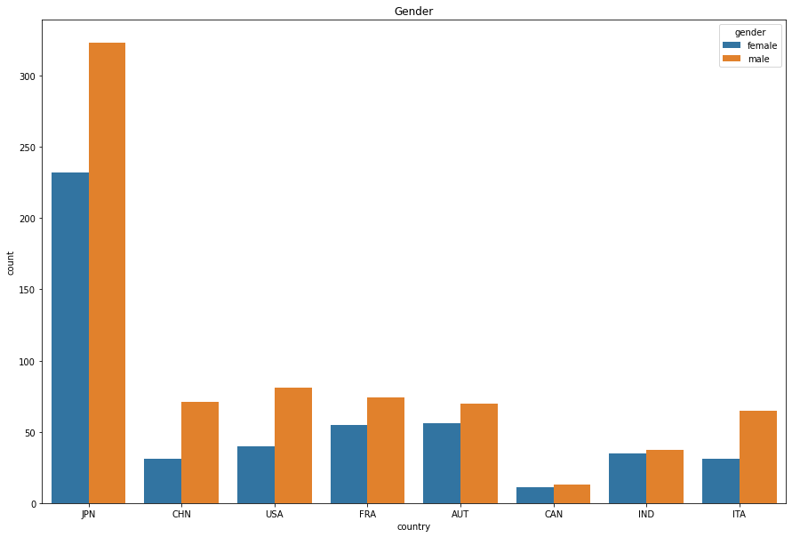
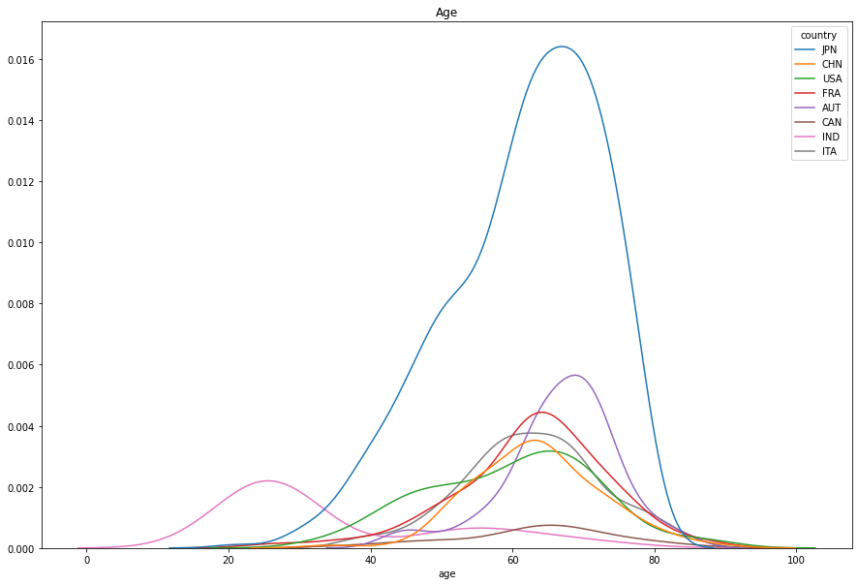
The Data

Slide 12
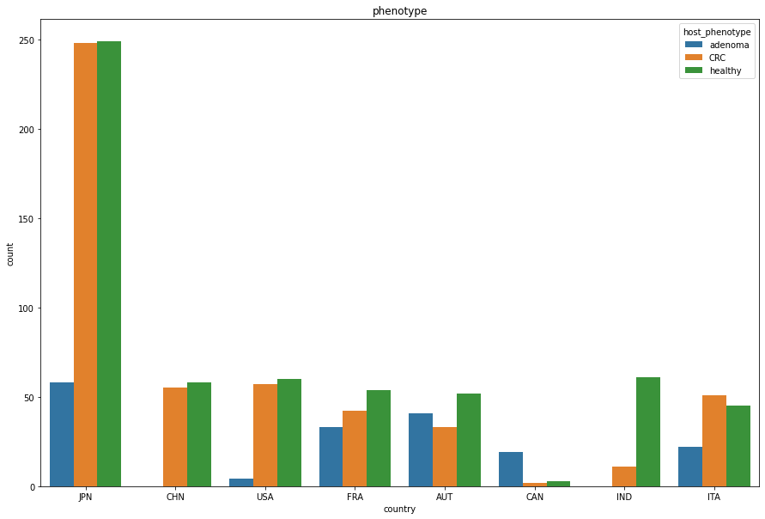
Extension - Adenoma
→ non-cancerous tumour → uncertain influence on CRC
Goal: Classify Healthy / Adenoma / CRC
(‘host_phenotype’)
Sensitivity > Specificity
→ minimize false negatives!

